Slide 1

Module 1: Introduction
CST402 DISTRIBUTED COMPUTING

Slide 2
CST402 DISTRIBUTED COMPUTING

Slide 3
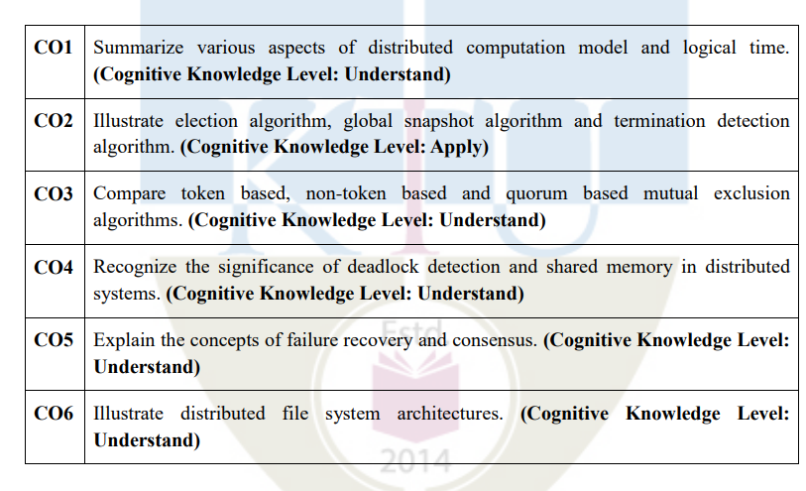
Course Outcome

Slide 4
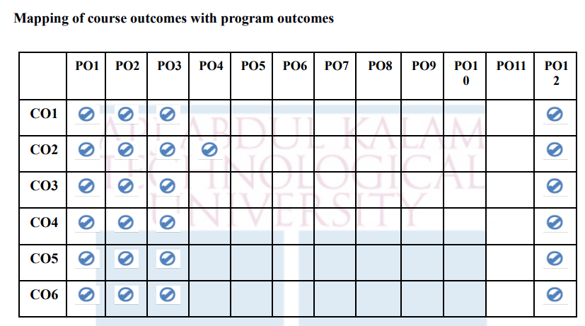

Slide 5
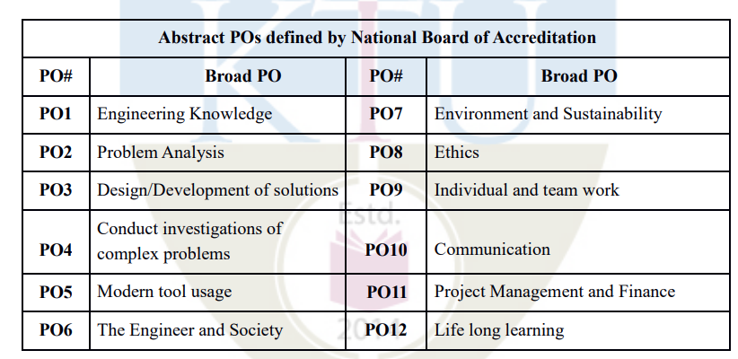

Slide 6
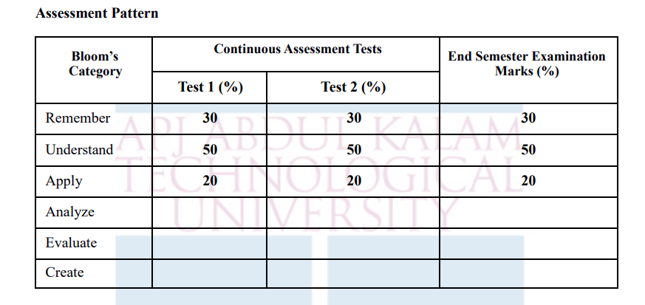

Slide 7
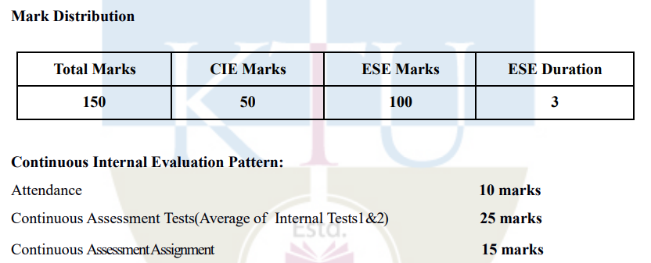

Slide 8
Syllabus- Distributed systems basics and Computation model
Distributed System – Definition, Relation to computer system components, Motivation, Primitives for distributed communication, Design issues, Challenges and applications.
A model of distributed computations – Distributed program, Model of distributed executions, Models of communication networks, Global state of a distributed system, Cuts of a distributed computation, Past and future cones of an event, Models of process communications.

Slide 9
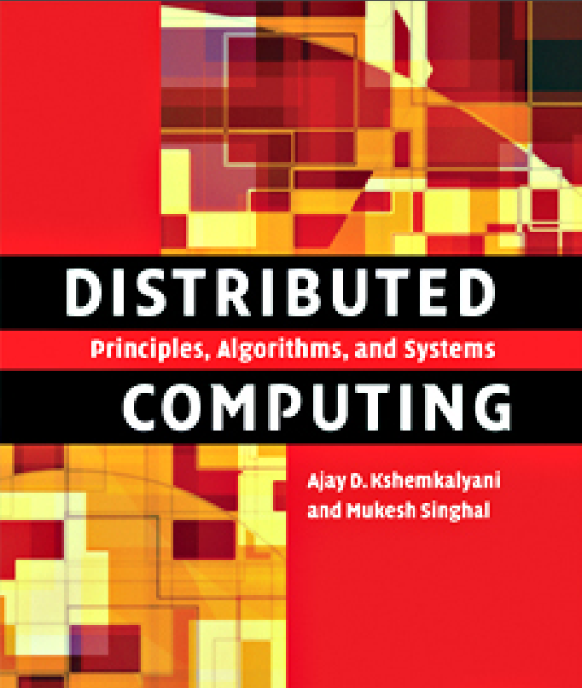

Slide 10
Distributed System
A distributed system is a collection of independent entities that cooperate to solve a problem that cannot be individually solved
A distributed system can be characterized as a collection of mostly autonomous processors communicating over a communication network

Slide 11
Distributed system has been characterized in one of several ways
You know you are using one when the crash of a computer you have never heard of prevents you from doing work--- prevents losing data in a computer crash
A collection of computers that do not share common memory or a common physical clock, that communicate by a messages passing over a communication network, and where each computer has its own memory and runs its own operating system
A collection of independent computers that appears to the users of the system as a single coherent computer
A term that describes a wide range of computers, from weakly coupled systems such as wide-area networks, to strongly coupled systems such as local area networks, to very strongly coupled systems such as multiprocessor systems

Slide 12
Features of DS
No common physical clock: This is an important assumption because it introduces the element of “distribution” in the system and gives rise to the inherent asynchrony amongst the processors.
No shared memory This is a key feature that requires message-passing for communication. This feature implies the absence of the common physical clock
Geographical separation The geographically wider apart that the processors are, the more representative is the system of a distributed system.
WAN
NOW/COW(network/cluster of workstations)--- eg, Google search engine
Autonomy and heterogeneity: The processors are “loosely coupled” in that they have different speeds and each can be running a different operating system, cooperate with one another by offering services or solving a problem jointly.

Slide 13
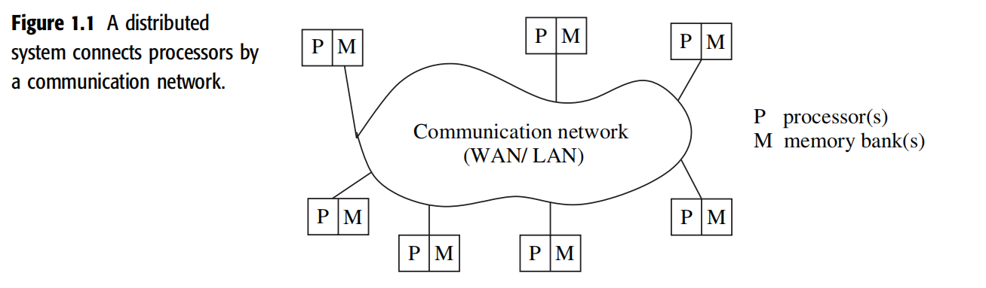
Relation to computer system components
Each computer has a memory-processing unit and the computers are connected by a communication network

Slide 14
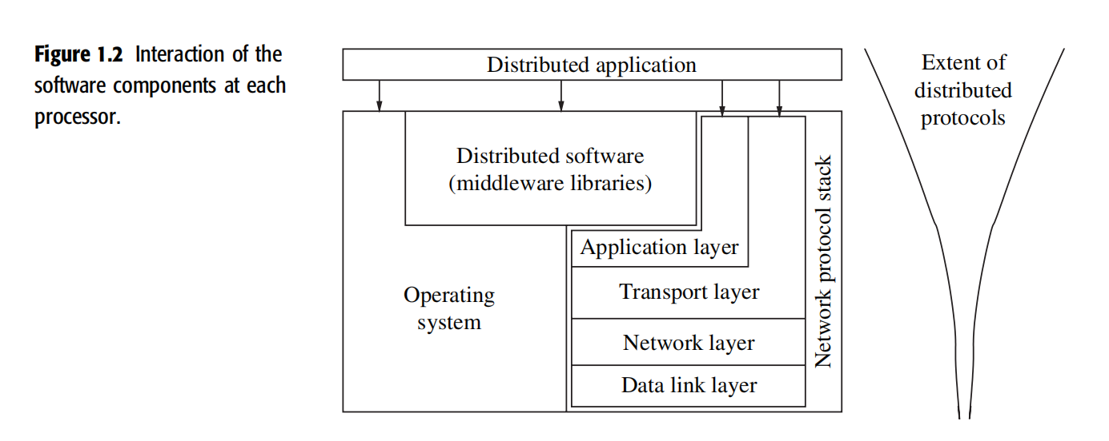
interaction of
software with system components at each processor
relationships of the software components that run on each of the computers and use the local operating system and network protocol stack for functioning

Slide 15
The distributed software is also termed as middleware.
A distributed execution is the execution of processes across the distributed system to collaboratively achieve a common goal.
An execution is also sometimes termed a computation or a run.

Slide 16
The distributed system uses a layered architecture to break down the complexity of system design.
The middleware is the distributed software that drives the distributed system, while providing transparency of heterogeneity at the platform level
The middleware layer does not contain the traditional application layer functions of the network protocol stack, such as http, mail, ftp, and telnet.
Various primitives and calls to functions defined in various libraries of the middleware layer are embedded in the user program code.
There exist several libraries to choose from to invoke primitives for the more common functions – such as reliable and ordered multicasting – of the middleware layer

Slide 17
Motivation
Inherently distributed computations: money transfer in banking, or reaching consensus among parties that are geographically distant
Resource sharing: distributed databases such as DB2 partition the data sets across several servers, in addition to replicating them at a few sites for rapid access as well as reliability
Access to geographically remote data and resources: data cannot be replicated at every site participating in the distributed execution because it may be too large or too sensitive to be replicated
Enhanced reliability: Availability, Integrity, Fault-tolerance
Increased performance/cost ratio: any task can be partitioned across the various computers in the distributed system
Scalability
Modularity and incremental expandability

Slide 18
Module 1: Primitives for distributed communication
CST402 DISTRIBUTED COMPUTING

Slide 19
Primitives for distributed communication
Blocking/non-blocking,
synchronous/asynchronous primitives
Processor synchrony
Libraries and standards

Slide 20
Blocking/non-blocking, synchronous/asynchronous primitives
Send()- has at least two parameters, the destination, and the buffer in the user space
Receive()- at least two parameters, the source from which the data is to be received and the user buffer into which the data is to be received

Slide 21
There are two ways of sending data when the Send primitive is invoked the
buffered option
The buffered option which is the standard option copies the data from the user buffer to the kernel buffer.
The data later gets copied from the kernel buffer onto the network.
unbuffered option
In the unbuffered option, the data gets copied directly from the user buffer onto the network.
For the Receive primitive, the buffered option is usually required because the data may already have arrived when the primitive is invoked, and needs a storage place in the kernel.

Slide 22
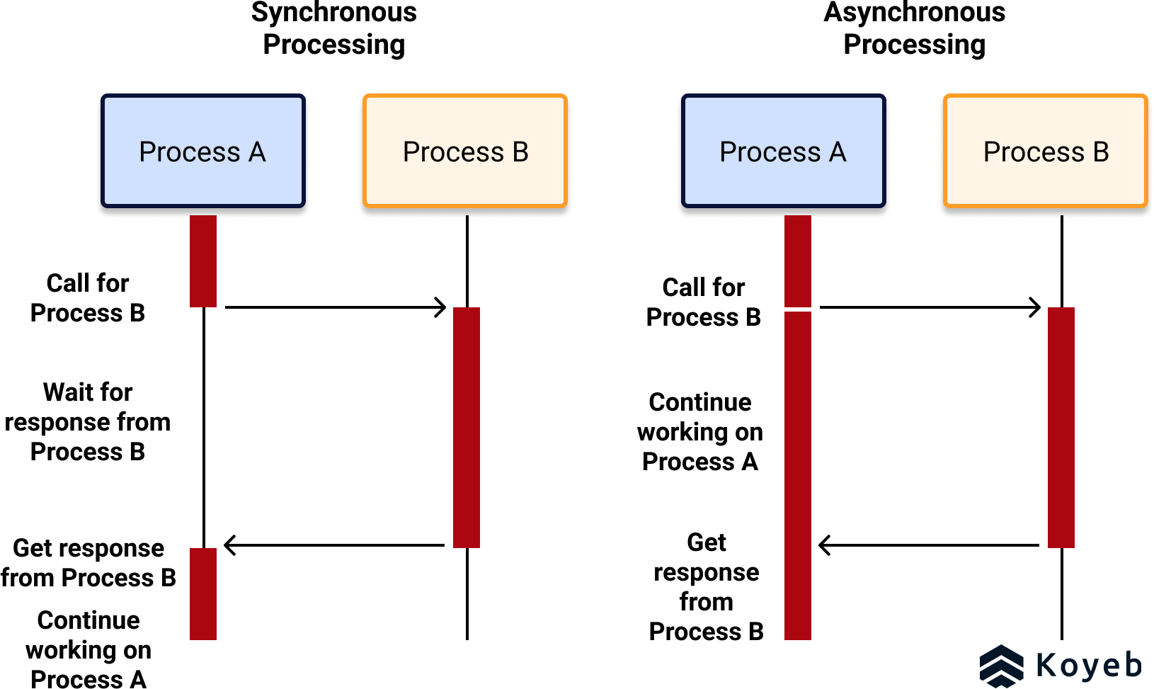
Synchronous primitives
A Send or a Receive primitive is synchronous if both the Send() and Receive() handshake with each other.
The processing for the Send primitive completes only after the invoking processor learns that the other corresponding Receive primitive has also been invoked and that the receive operation has been completed.
The processing for the Receive primitive completes when the data to be received is copied into the receiver’s user buffer.

Slide 23
Asynchronous primitives
A Send primitive is said to be asynchronous if control returns back to the invoking process after the data item to be sent has been copied out of the user-specified buffer.
It does not make sense to define asynchronous Receive primitives.

Slide 24
Blocking primitives
A primitive is blocking if control returns to the invoking process after the processing for the primitive (whether in synchronous or asynchronous mode) completes.

Slide 25
Non-blocking primitives
A primitive is non-blocking if control returns back to the invoking process immediately after invocation, even though the operation has not completed.
For a non-blocking Send, control returns to the process even before the data is copied out of the user buffer.
For a non-blocking Receive, control returns to the process even before the data may have arrived from the sender.

Slide 26
Non Blocking primitive - handle
For non-blocking primitives, a return parameter on the primitive call returns a system-generated handle which can be later used to check the status of completion of the call.
The process can check for the completion of the call in two ways.
First, it can keep checking (in a loop or periodically) if the handle has been flagged or posted.
Second, it can issue a Wait with a list of handles as parameters.

Slide 27
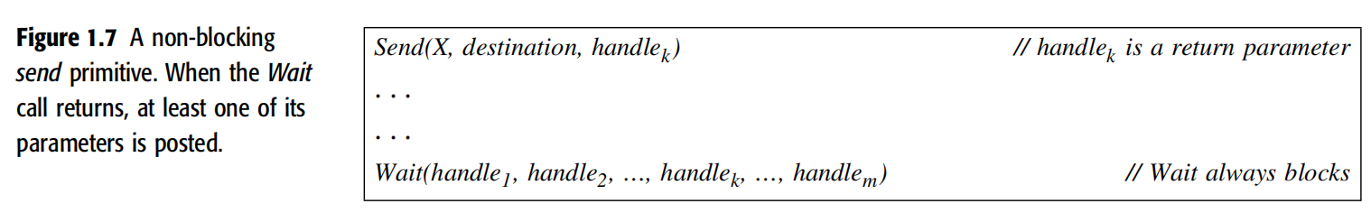
Blocking wait () on non blocking primitives
The Wait call usually blocks until one of the parameter handles is posted.

Slide 28
Blocking wait () on non blocking primitives and posting
If at the time that Wait() is issued, the processing for the primitive has completed, the Wait returns immediately
The completion of the processing of the primitive is detectable by checking the value of handle_{k}.
If the processing of the primitive has not completed, the Wait blocks and waits for a signal to wake it up.
When the processing for the primitive completes,
the communication subsystem software sets the value of handle_{k}
and wakes up (signals) any process with a Wait call blocked on this handle_{k}.
This is called posting the completion of the operation.

Slide 29
Four Versions of the Send primitive
synchronous blocking,
synchronous non-blocking,
asynchronous blocking, and
asynchronous non-blocking

Slide 30
Two Versions of the receive primitive
Blocking synchronous
Non-blocking synchronous

Slide 31
Timing Diagram
Here, three time lines are shown for each process:
(1) for the process execution,
(2) for the user buffer from/to which data is sent/received, and
(3) for the kernel/communication subsystem.

Slide 32
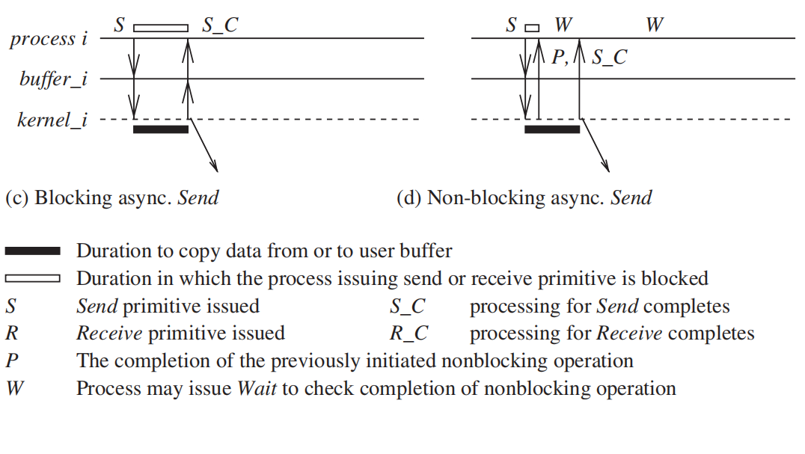

Slide 33
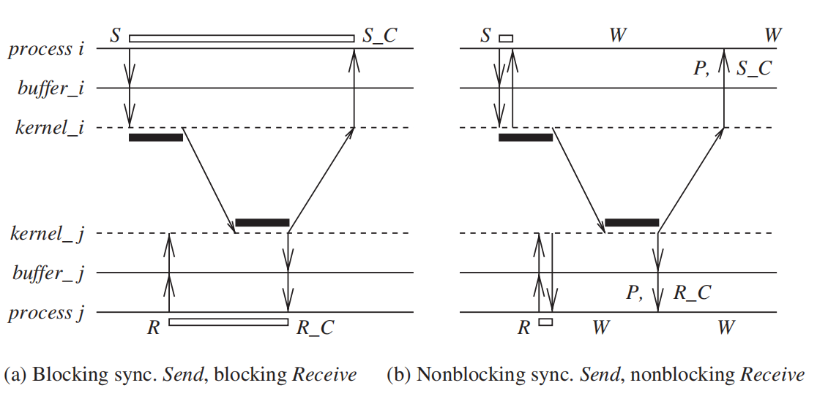
Blocking synchronous Send
The data gets copied from the user buffer to the kernel buffer and is then sent over the network.
After the data is copied to the receiver’s system buffer and a Receive call has been issued, an acknowledgement back to the sender causes control to return to the process that invoked the Send operation and completes the Send

Slide 34
Blocking Receive
The Receive call blocks until the data expected arrives and is written in the specified user buffer.
Then control is returned to the user process.

Slide 35
Non-blocking synchronous Send
Control returns back to the invoking process as soon as the copy of data from the user buffer to the kernel buffer is initiated.
A parameter in the non-blocking call also gets set with the handle of a location that the user process can later check for the completion of the synchronous send operation.
The location gets posted after an acknowledgement returns from the receiver
The user process can keep checking for the completion of the non-blocking synchronous Send by testing the returned handle, or it can invoke the blocking Wait operation on the returned handle

Slide 36
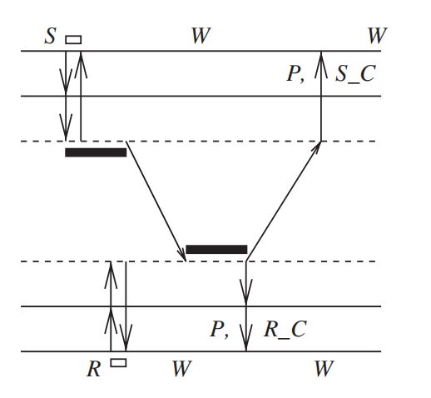
Non-blocking Receive
The Receive call will cause the kernel to register the call and return the handle of a location that the user process can later check for the completion of the non-blocking Receive operation.
This location gets posted by the kernel after the expected data arrives and is copied to the user-specified buffer.
The user process can check for the completion of the non-blocking Receive by invoking the Wait operation on the returned handle.

Slide 38
Blocking asynchronous Send
The user process that invokes the Send is blocked until the data is copied from the user’s buffer to the kernel buffer.
For the unbuffered option, the user process that invokes the Send is blocked until the data is copied from the user’s buffer to the network.

Slide 39
Non-blocking asynchronous Send
The user process that invokes the Send is blocked until the transfer of the data from the user’s buffer to the kernel buffer is initiated.
Control returns to the user process as soon as this transfer is initiated, and a parameter in the non-blocking call also gets set with the handle of a location that the user process can check later using the Wait operation for the completion of the asynchronous Send operation.
The asynchronous Send completes when the data has been copied out of the user’s buffer.
The checking for the completion may be necessary if the user wants to reuse the buffer from which the data was sent.

Slide 41
A synchronous Send is easier to use from a programmer’s perspective because the handshake between the Send and the Receive makes the communication appear instantaneous
“instantaneity” is, of course, only an illusion
The Receive may not get issued until much after the data arrives at Pj, in which case the data arrived would have to be buffered in the system buffer at Pj and not in the user buffer.
At the same time, the sender would remain blocked.
Thus, a synchronous Send lowers the efficiency within process Pi.

Slide 42
The non-blocking asynchronous Send is useful when a large data item is being sent because it allows the process to perform other instructions in parallel with the completion of the Send.
The non-blocking synchronous Send also avoids the potentially large delays for handshaking, particularly when the receiver has not yet issued the Receive call.
The non-blocking Receive is useful when a large data item is being received and/or when the sender has not yet issued the Send call,
because it allows the process to perform other instructions in parallel with the completion of the Receive.
If the data has already arrived, it is stored in the kernel buffer, and it may take a while to copy it to the user buffer specified in the Receive call.
For non-blocking calls, however, the burden on the programmer increases because he or she has to keep track of the completion of such operations in order to meaningfully reuse (write to or read from) the user buffers

Slide 43
Primitives for distributed communication
Blocking/non-blocking, synchronous/asynchronous primitives
Processor synchrony
Libraries and standards

Slide 44
Processor synchrony
Processor synchrony indicates that all the processors execute in lock-step with their clocks synchronized.
As this synchrony is not attainable in a distributed system, what is more generally indicated is that for a large granularity of code, usually termed as a step, the processors are synchronized.
This abstraction is implemented using some form of barrier synchronization to ensure that no processor begins executing the next step of code until all the processors have completed executing the previous steps of code assigned to each of the processors.

Slide 45
Design issues and challenges
3 Categories:
System perspective, having a greater component related to systems design and operating systems design, or
Algorithmic challenges, having a greater component related to algorithm design, or
Applications of Distributed computing and new challenges: emerging from recent technology advances and/or driven by new applications

Slide 46
Distributed systems challenges from a system perspective
The following functions must be addressed when designing and building a distributed system:
Communication
Processes
Naming
Synchronization
Data storage and access
Consistency and replication
Fault tolerance
Security
Applications Programming Interface (API) and transparency
Scalability and modularity

Slide 47
1. Communication
Designing mechanisms for communication among the processes in the network
Some example mechanisms :
remote procedure call (RPC),
remote object invocation (ROI),
message-oriented communication versus stream-oriented communication.

Slide 48
2. Processes
Some of the issues involved are:
management of processes and threads at clients/servers;
code migration
design of software and mobile agents.

Slide 49
3. Naming
need easy to use and robust schemes for names, identifiers, and addresses ->for locating resources and processes in a transparent and scalable manner
Naming in mobile systems provides additional challenges because naming cannot easily be tied to any static geographical topology.

Slide 50
4. Synchronization
Mechanisms for synchronization or coordination among the processes needed
Mutual exclusion -the classical example of synchronization,
Different forms of synchronization needed
leader election ,
synchronizing physical clocks
devising logical clocks that capture the essence of the passage of time
global state recording algorithms etc.

Slide 51
5. Data storage and access
Schemes for data storage and accessing the data in a fast and scalable manner across the network are important for efficiency.
File system design have to be reconsidered in the setting of a distributed system.

Slide 52
6. Consistency and replication
Replication ->To avoid bottlenecks, provide fast access to data, and to provide scalability
Issues:
managing the replicas,
consistency among the replicas/caches in a distributed setting
E.g. issue is deciding the level of granularity (i.e., size) of data access.

Slide 53
7. Fault tolerance
Maintaining correct and efficient operation in spite of failures of links, nodes, and processes
Some of the mechanisms to provide fault-tolerance are:
Process resilience,
reliable communication,
distributed commit, checkpointing and recovery,
agreement and consensus, failure detection, and self-stabilization

Slide 54
8. Security
Distributed systems security involves various aspects of
cryptography,
secure channels,
authorization ,
access control,
key management – generation and distribution,
secure group management

Slide 55
9. Applications Programming Interface (API) and transparency
Transparency deals with hiding the implementation policies from the user, and can be classified as follows
Access transparency hides differences in data representation on different systems and provides uniform operations to access system resources.
Location transparency makes the locations of resources transparent to the users.
Migration transparency allows relocating resources without changing names.
Relocation transparency: The ability to relocate the resources as they are being accessed is.
Replication transparency does not let the user become aware of any replication.
Concurrency transparency deals with masking the concurrent use of shared resources for the user.
Failure transparency refers to the system being reliable and fault-tolerant.

Slide 56
10. Scalability and modularity
The algorithms, data (objects), and services must be as distributed as possible.
Various techniques such as replication, caching and cache management, and asynchronous processing help to achieve scalability.

Slide 57
Algorithmic challenges in distributed computing
Designing useful execution models and frameworks
Dynamic distributed graph algorithms and distributed routing algorithms
Time and global state in a distributed system
Synchronization/coordination mechanisms
Group communication, multicast, and ordered message delivery
Monitoring distributed events and predicates
Distributed program design and verification tools
Debugging distributed programs
Data replication, consistency models, and caching

Slide 58
Designing useful execution models and frameworks
The interleaving model and partial order model are two widely adopted models of distributed system executions.
Useful for operational reasoning , design of distributed algorithms
The input/output automata model and the TLA (temporal logic of actions)- other egs.

Slide 59
Dynamic distributed graph algorithms and distributed routing algorithms
The distributed system is modeled as a distributed graph,
The graph algorithms form the building blocks for –> higher level communication, data dissemination, object location, and object search functions.
The algorithms need to deal with dynamically changing graph characteristics, such as to model varying link loads in a routing algorithm.
The efficiency of these algorithms impacts user-perceived latency ,traffic and load or congestion in the network
The design of efficient distributed graph algorithms ->paramount importance

Slide 60
Time and global state in a distributed system
The challenges pertain to providing accurate physical time, and to providing a variant of time, called logical time
Logical time is relative time, and eliminates the overheads of providing physical time for applications where physical time is not required. More importantly, logical time can
capture the logic and inter-process dependencies within the distributed program, and also
track the relative progress at each process.
It is not possible for any one process to directly observe a meaningful global state across all the processes, without using extra state-gathering effort which needs to be done in a coordinated manner

Slide 61
Synchronization/coordination mechanisms
Synchronization is essential to overcome the limited observation of the system state from the viewpoint of any one process.
Overcoming this limited observation is necessary for taking any actions that would impact other processes.
The synchronization mechanisms can also be viewed as resource management and concurrency management mechanisms to streamline the behavior of the processes that would otherwise act independently.

Slide 62
Problems Requiring Synchronization
Physical clock synchronization
Leader election
Mutual exclusion
Deadlock detection and resolution
Termination detection
Garbage collection

Slide 63
Leader election
All the processes need to agree on which process will play the role of a distinguished process – called a leader process.
A leader is necessary even for many distributed algorithms because there is often some asymmetry as in initiating some action like a broadcast or collecting the state of the system, or in “regenerating” a token that gets “lost” in the system

Slide 64
Group communication, multicast, and ordered message delivery
A group is a collection of processes that share a common context and collaborate on a common task within an application domain.
Specific algorithms need to be designed to enable efficient group communication and group management wherein processes can join and leave groups dynamically, or even fail.
When multiple processes send messages concurrently, different recipients may receive the messages in different orders, possibly violating the semantics of the distributed program.
Hence, formal specifications of the semantics of ordered delivery need to be formulated, and then implemented.

Slide 65
Monitoring distributed events and predicates
Predicates defined on program variables that are local to different processes are used for specifying conditions on the global system state, and are useful for applications such as debugging, sensing the environment, and in industrial process control.
On-line algorithms for monitoring such predicates are hence important.
An important paradigm for monitoring distributed events is that of event streaming, wherein streams of relevant events reported from different processes are examined collectively to detect predicates.
Typically, the specification of such predicates uses physical or logical time relationships.

Slide 66
Distributed program design and verification tools
Methodically designed and verifiably correct programs can greatly reduce the overhead of software design, debugging, and engineering.
Designing mechanisms to achieve these design and verification goals is a challenge.

Slide 67
Debugging distributed programs
Debugging sequential programs is hard; debugging distributed programs is that much harder because of the concurrency in actions and the ensuing uncertainty due to the large number of possible executions defined by the interleaved concurrent actions.
Adequate debugging mechanisms and tools need to be designed to meet this challenge.

Slide 68
Data replication, consistency models, and caching
Fast access to data and other resources requires them to be replicated in the distributed system.
Managing such replicas in the face of updates introduces the problems of ensuring consistency among the replicas and cached copies.
Additionally, placement of the replicas in the systems is also a challenge because resources usually cannot be freely replicated.

Slide 69
Distributed Shared Memory abstraction
Simplifies task of a programmer.
Only read and write , instead of communication primitives
More expensive

Slide 70
Reliable and fault tolerant DS
Consensus algorithms : correctly functioning processes to reach consensus/agreement , in the presence of malicious processes
Replication and replica management
Voting and quorum systems
Distributed databases and distributed commit
Self stabilizing systems
Checkpointing and recovery algorithms
Failure detectors

Slide 71
Applications of distributed computing and newer challenges
Mobile systems
Sensor networks
Ubiquitous or pervasive computing
Peer-to-peer computing
Publish-subscribe, content distribution, and multimedia
Distributed agents
Distributed data mining
Grid computing
Security in distributed systems

Slide 72
1. Mobile systems
Mobile systems typically use wireless communication which is based on electromagnetic waves and utilizes a shared broadcast medium.
Characteristics of communication are different;
Set of problems such as
routing,
location management,
channel allocation,
localization and position estimation, and
the overall management of mobility

Slide 73
Mobile systems – 2 architectures
Base-station approach, as the cellular approach
a cell which is the geographical region within range of a static but powerful base transmission station is associated with that base station
All mobile processes in the cell communicate with rest of the system via base station
ad-hoc network approach
no base station
All responsibility for communication is distributed among the mobile nodes

Slide 74
2. Sensor networks
A sensor is a processor with an electro-mechanical interface that is capable of sensing physical parameters, such as temperature, velocity, pressure, humidity, and chemicals
Sensors may be mobile or static;
sensors may communicate wirelessly, although they may also communicate across a wire when they are statically installed.
Sensors may have to self-configure to form an ad-hoc network, which introduces a whole new set of challenges, such as position estimation and time estimation

Slide 75
3. Ubiquitous or pervasive computing
Processors are embedded in and perform application functions in the background .intelligent home, smart workplace etc . Egs.
Ubiquitous systems are distributed systems, wireless communication and sensor and actuator mechanisms
They can be self-organizing and network-centric, while also being resource constrained
Characterized as having many small processors operating collectively in a dynamic ambient network.
The processors may be connected to more powerful networks and processing resources in the background for processing and collating data.

Slide 76
4. Peer-to-peer computing
Represents computing over an application layer network , all interactions among the processors are at a “peer” level, without any hierarchy among the processors.
Self-organizing, and may or may not have a regular structure to the network
No central directories for name resolution and object lookup
Challenges: Object storage mechanisms, efficient object look up and retrieval, dynamic reconfiguration, replication strategies etc.

Slide 77
5. Publish-subscribe, content distribution, and multimedia
In a dynamic environment where the information constantly fluctuates (varying stock prices), there needs to be:
an efficient mechanism for distributing this information (publish),
an efficient mechanism to allow end users to indicate interest in receiving specific kinds of information (subscribe), and
an efficient mechanism for aggregating large volumes of published information and filtering it as per the user’s subscription filter
Conent distribution: specific info ->distributed to interested processes
multimedia data is usually very large and information-intensive, requires compression, and special synchronization during storage and playback

Slide 78
6. Distributed agents
Software processes/robots that can move around the system, do specific tasks for which specifically programmed
Agents collect, process information, exchange information with other agents
Agents cooperate as in an ant colony, can also have friendly competition, as in a free market economy.
Challenges in distributed agent systems include coordination mechanisms among the agents, controlling the mobility of the agents, and their software design and interfaces.
Research in agents is inter-disciplinary: spanning artificial intelligence, mobile computing, economic market models, software engineering, and distributed computing.

Slide 79
7. Distributed data mining
Datamining->examine large amounts of data-detect patterns/trends,to mine/extract useful info
Mining ->db+AI techniques to a data repository
The data is necessarily distributed and cannot be collected in a single repository, as in banking applications,or in atmospheric weather prediction
Efficient distributed datamining algorithms required

Slide 80
8. Grid computing
Grid Computing is a subset of distributed computing, where a virtual supercomputer comprises machines on a network connected by some bus, mostly Ethernet or sometimes the Internet.
It can also be seen as a form of Parallel Computing where instead of many CPU cores on a single machine, it contains multiple cores spread across various locations.
Many challenges in making grid computing a reality include:
scheduling jobs in such a distributed environment,
a framework for implementing quality of service and real-time guarantees,
Security of individual machines as well as of jobs being executed in this setting.

Slide 81
9. Security in distributed systems
The traditional challenges of security in a distributed setting include:
confidentiality (ensuring that only authorized processes can access certain information),
authentication (ensuring the source of received information and the identity of the sending process), and
availability (maintaining allowed access to services despite malicious actions).
The goal is to meet these challenges with efficient and scalable solutions.
These basic challenges have been addressed in traditional distributed settings.

Slide 82
A model of distributed computations

Slide 83
A distributed system consists of a set of processors that are connected by a communication network.
The communication network provides the facility of information exchange among processors.
The communication delay is finite but unpredictable.
The processors do not share a common global memory and communicate solely by passing messages over the communication network.
There is no physical global clock in the system to which processes have instantaneous access.
The communication medium may deliver messages out of order, messages may be lost, garbled, or duplicated due to timeout and retransmission, processors may fail, and communication links may go down.
The system can be modeled as a directed graph in which vertices represent the processes and edges represent unidirectional communication channels.

Slide 84
A distributed application runs as a collection of processes on a distributed system

Slide 85
A distributed program
A distributed program is composed of a set of n asynchronous processes p1, p2, , pi, , pn that communicate by message passing over the communication network.
we assume that each process is running on a different processor
The processes do not share a global memory and communicate solely by passing messages
Cij: denote the channel from process pi to process pj
mij: denote a message sent by pi to pj.

Slide 86
A distributed program contd…
Communication delay is finite and unpredictable
Processes do not share a global clock that is instantaneously accessible to these processes
Process execution and message transfer are asynchronous
a process may execute an action spontaneously
a process sending a message does not wait for the delivery of the message to be complete

Slide 87
A distributed program contd…
The global state of a distributed computation is composed of the states of the processes and the communication channels
The state of a process is characterized by the state of its local memory and depends upon the context.
The state of a channel is characterized by the set of messages in transit in the channel.

Slide 88
A model of distributed executions
The execution of a process consists of a sequential execution of its actions.
The actions are atomic and the actions of a process are modeled as three types of events,
internal events,
message send events, and
Message receive events
For a message m, let send(m) and rec(m) denote its send and receive events

Slide 89
Model of distributed executions contd..
The occurrence of events changes the states of respective processes and channels->transitions in the global system state.
An internal event changes the state of the process at which it occurs
A send event (or a receive event) changes the state of the process that sends (or receives) the message and the state of the channel on which the message is sent (or received)
An internal event only affects the process at which it occurs

Slide 90
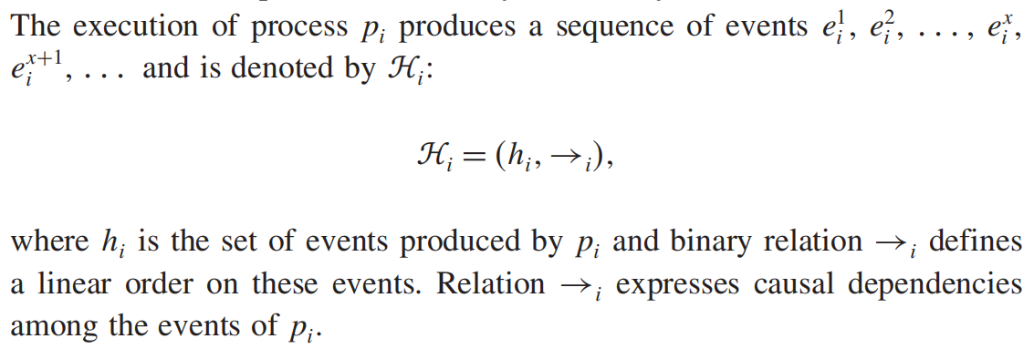

Model of distributed executions contd..
Let $e_{i}^{x}$ denote the x_{th} event at process pi
The events at a process are linearly ordered by their order of occurrence.

Slide 91
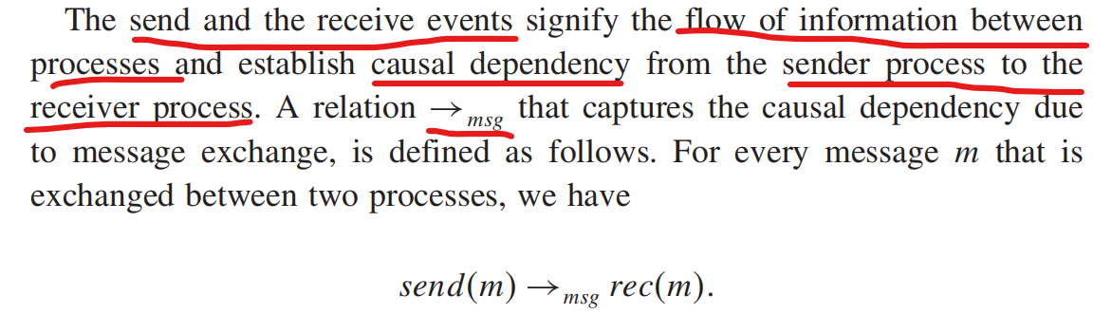

Slide 92
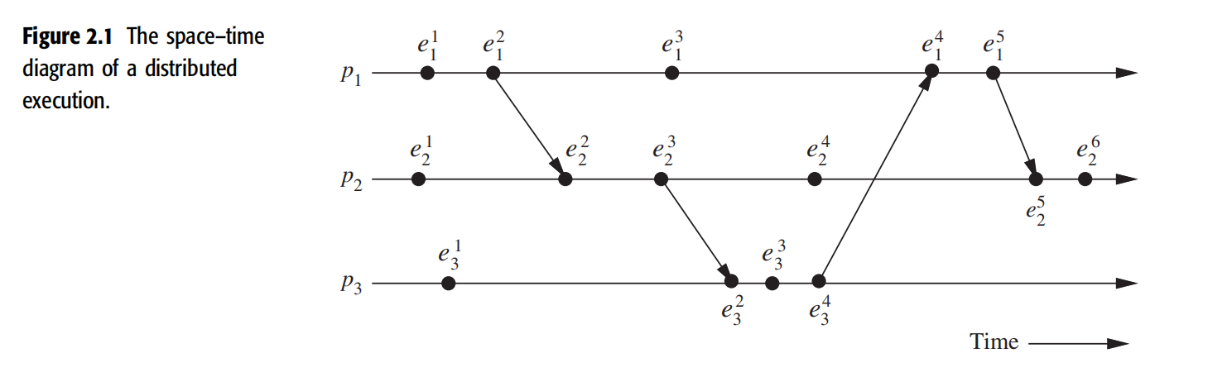
Space–Time Diagram of a Distributed Execution involving Three Processes
A horizontal line represents the progress of the process;
a dot indicates an event;
a slant arrow indicates a message transfer.

Slide 93
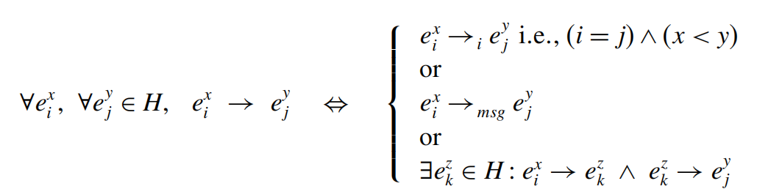

Causal precedence relation
The execution of a distributed application results in a set of distributed events produced by the processes
Let H =∪_{i}h_{i} denote the set of events executed in a distributed computation
causal dependencies between events in the distributed execution: define a binary relation on the set H, denoted as →
The causal precedence relation induces an irreflexive partial order on the events of a distributed computation that is denoted as

Slide 94


For example
relation → is Lamport’s “happens before” relation
For any two events dependent on event ei and ej, if ei → ej, then event ej is directly or transitively dependent on event ei;
graphically, it means that there exists a path consisting of message arrows and process-line segments in the space–time diagram that starts at ei and ends at ej.
relation → denotes flow of information in a distributed computation and ei → ej dictates that all the information available at ei is potentially accessible at ej.
Eg: event has the knowledge of all other events shown in the figure

Slide 95




For any two events ei and ej, denotes
event ej does not directly or transitively dependent on event ei
event ei does not causally affect event ej.
Event ej is not aware of the execution of ei or any event executed after ei on the same process.
For example
two rules:
For any two events ei and ej, if ei → ej and ej → ei, then events ei and ej are said to be concurrent and the relation is denoted as ei||ej
relation || is not transitive

Slide 96
Causal precedence relation contd..
for any two events ei and ej in a distributed execution,
ei → ej or
ej → ei, or
ei ||ej

Slide 97
Logical vs. Physical Concurrency
In a distributed computation, two events are logically concurrent if and only if they do not causally affect each other.
Physical concurrency, on the other hand, has a meaning that the events occur at the same instant in physical time.
Two or more events may be logically concurrent even though they do not occur at the same instant in physical time.
However, if processor speed and message delays would have been different, the execution of these events could have very well coincided in physical time.
Whether a set of logically concurrent events coincide in the physical time or not, does not change the outcome of the computation.
Therefore, even though a set of logically concurrent events may not have occurred at the same instant in physical time, we can assume that these events occurred at the same instant in physical time.

Slide 98
Models of communication networks
3 models of the service provided by communication networks
1. FIFO (first-in, first-out) Model:
Each channel acts like a FIFO Message Queue
Message ordering is preserved by a channel
2. Non-FIFO Model:
a channel acts like a set in which the sender process adds messages and the receiver process removes messages from it in a random order
3. Causal ordering Model

Slide 99
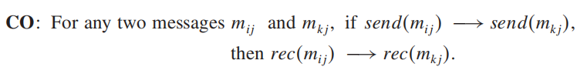
Models of communication networks contd…
Causal ordering:
based on Lamport’s “happens before” relation
A system that supports the causal ordering model satisfies the following property
this property ensures that causally related messages destined to the same destination are delivered in an order that is consistent with their causality relation.

Slide 100
Models of communication networks contd…
Causal ordering model is useful in developing distributed algorithms.
simplifies the design of distributed algorithms ->provides a built-in synchronization
For example, in replicated database systems, it is important that every process responsible for updating a replica receives the updates in the same order to maintain database consistency.
Without causal ordering, each update must be checked to ensure that database consistency is not being violated. Causal ordering eliminates the need for such checks.

Slide 101
Global state of a distributed system
The global state of a distributed system is a collection of the local states of its components->processes and the communication channels
The state of a process ->defined by contents of processor registers, stacks, local memory, etc. and depends on the local context of the distributed application
The state of a channel -> the set of messages in transit in the channel
The occurrence of events changes the states of respective processes and channels, thus causing transitions in global system state. For eg,
an internal event changes the state of the process at which it occurs.
A send event (or a receive event) changes the state of the process that sends (or receives) the message and the state of the channel on which the message is sent (or received)

Slide 102





Let denote the state of process pi after the occurrence of event and
before the event
denotes the initial state of process pi
is a result of the execution of all the events executed by process pi till .

Slide 103
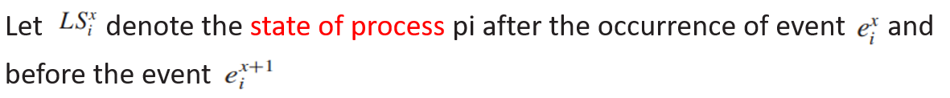
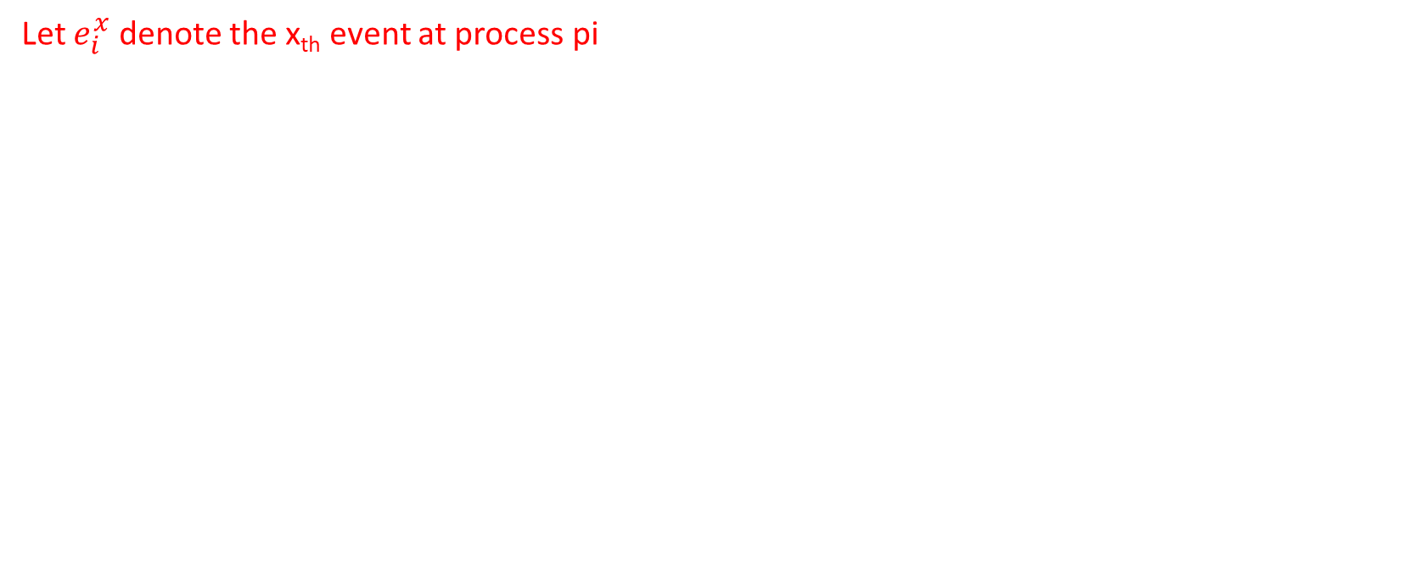
Global state of a distributed system contd…
Let $e_{i}^{x}$ denote the x_{th} event at process pi

Slide 104
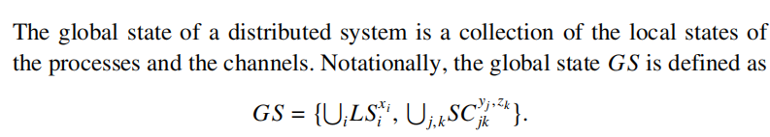
Global state
States Channels
Even if the state of all the components in a distributed system has not been recorded at the same instant, such a state will be meaningful provided every message that is recorded as received is also recorded as sent.
Basic idea is that an effect should not be present without its cause.
A message cannot be received if it was not sent; that is, the state should not violate causality.
Such states are called consistent global states and are meaningful global states.
Inconsistent global states are not meaningful in the sense that a distributed system can never be in an inconsistent state.

Slide 105
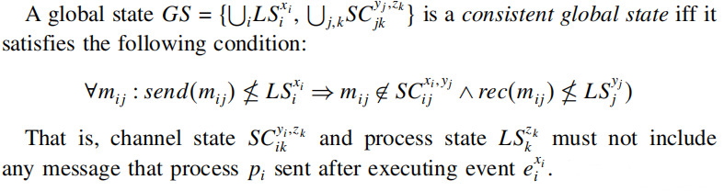
Global state contd…

Slide 106
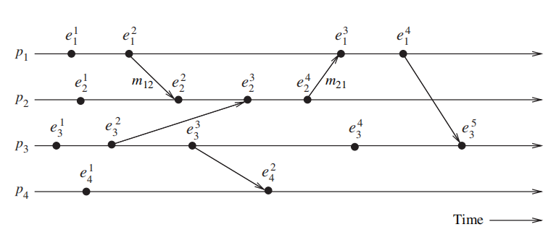


A global state GS1 consisting of local states is inconsistent because
the state of p2 has recorded the receipt of message m12,
however, the state of p1 has not recorded its send.
On the contrary, a global state GS2 consisting of local states is consistent;
all the channels are empty except C₂₁ that contains message m₂₁

Slide 107
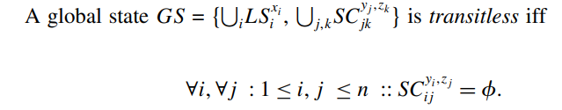
Global state contd…
Transit-less : A global state is transit –less, if all channels are recorded empty
Strongly consistent : A global state is Strongly consistent iff It is transit – less as well as consistent
Designing efficient algms for recording global state of a DS is an important Problem

Slide 108
Cuts of a distributed computation
In the space–time diagram of a distributed computation, a zigzag line joining one arbitrary point on each process line is termed a cut in the computation.
slices the space–time diagram,
Sets events in the distributed computation, into a PAST and a FUTURE
The PAST contains all the events to the left of the cut and the FUTURE contains all the events to the right of the cut.
For a cut C, PAST(C) -> set of events in the PAST, FUTURE(C) denote the FUTURE of C, respectively.
Every cut corresponds to a global state and every global state can be graphically represented as a cut in the computation’s space–time diagram

Slide 109
Cuts of a distributed computation contd…
A consistent global state corresponds to a cut in which every message received in the PAST of the cut was sent in the PAST of that cut.
Such a cut is known as a consistent cut.
All messages that cross the cut from the PAST to the FUTURE are in transit in the corresponding consistent global state.
A cut is inconsistent if a message crosses the cut from the FUTURE to the PAST

Slide 110
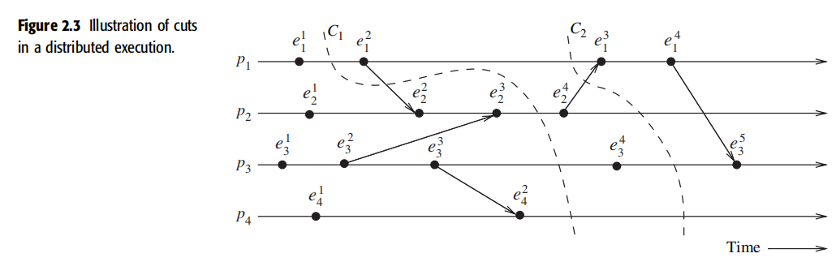
C1 is an inconsistent cut, whereas C2 is a consistent cut.

Slide 111
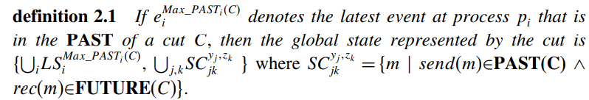
Cuts of a distributed computation contd…

Slide 112

Past and future cones of an event
An event ej could have been affected only by all events ei such that ei → ej and
all the information available at ei could be made accessible at ej
All such events ei belong to the past of ej.
Past(ej) denote all events in the past of ej in a computation (H, →). Then,

Slide 113
Past cone of an event

Slide 114
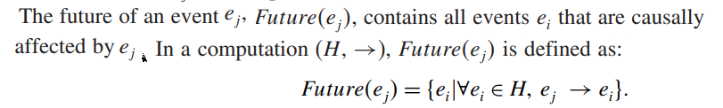
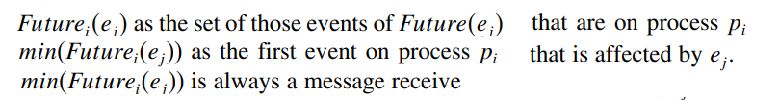
Future cone of an event

Slide 115
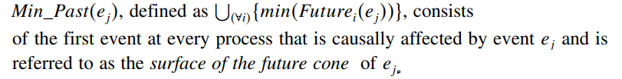
Future cone of an event contd…

Slide 116
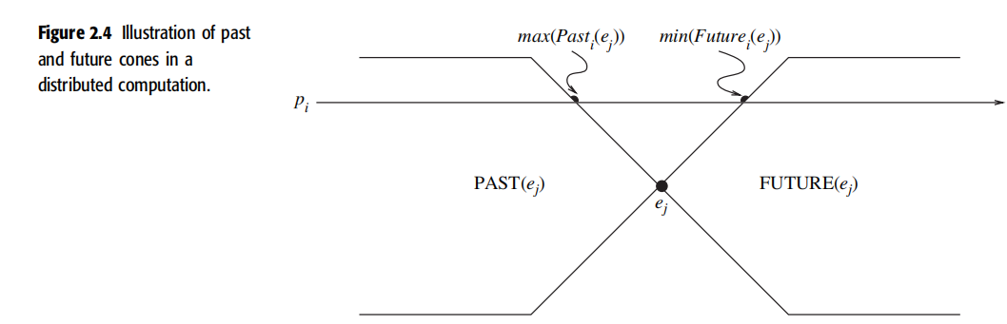

Slide 117
Models of process communications
There are two basic models of process communications
synchronous
asynchronous.

Slide 118
Models of process communications contd..
The synchronous communication model is a blocking type where on a message send, the sender process blocks until the message has been received by the receiver process.
The sender process resumes execution only after it learns that the receiver process has accepted the message.
Thus, the sender and the receiver processes must synchronize to exchange a message.

Slide 119
Models of process communications contd..
Asynchronous communication model is a non-blocking type where the sender and the receiver do not synchronize to exchange a message.
After having sent a message, the sender process does not wait for the message to be delivered to the receiver process.
The message is buffered by the system and is delivered to the receiver process when it is ready to accept the message.
A buffer overflow may occur if a process sends a large a number of messages in a burst to another process.
Asynchronous communication provides higher parallelism because the sender process can execute while the message is in transit to the receiver
Due to higher degree of parallelism and non-determinism, it is much more difficult to design, verify, and implement distributed algorithms for asynchronous communications

